Slide 1
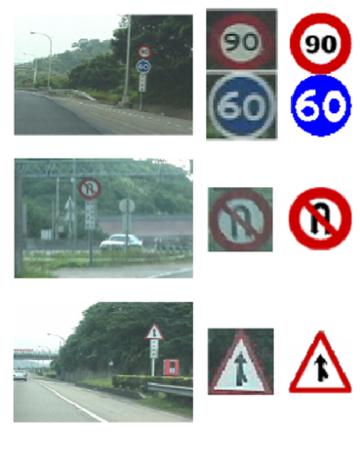
Traffic Sign and Vehicle Classification
Name: Harsh Sandip Kothari
Student ID: 934-062-578

Slide 2
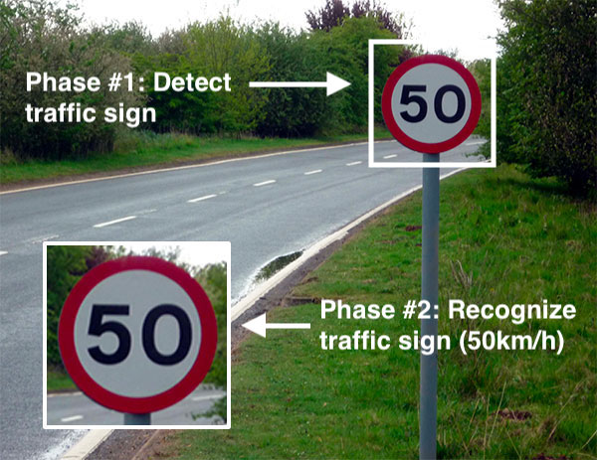
Problem statement
Self-driving cars need traffic sign recognition in order to properly parse and understand the roadway.
Traffic sign classification is the process of automatically recognizing traffic signs along the road, including speed limit signs, yield signs, merge signs, etc.

Slide 3
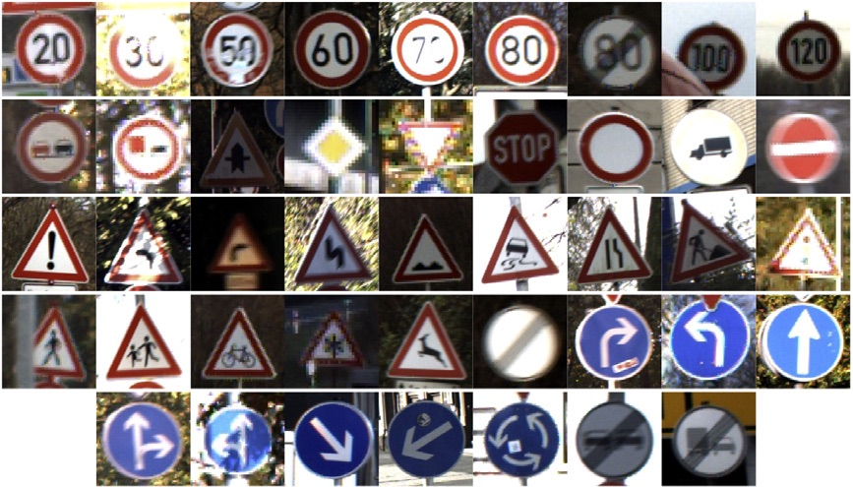
Dataset
GTSRB - German Traffic Sign Recognition Benchmark
43 different classes of images and more than 50,000 images in total

Slide 4
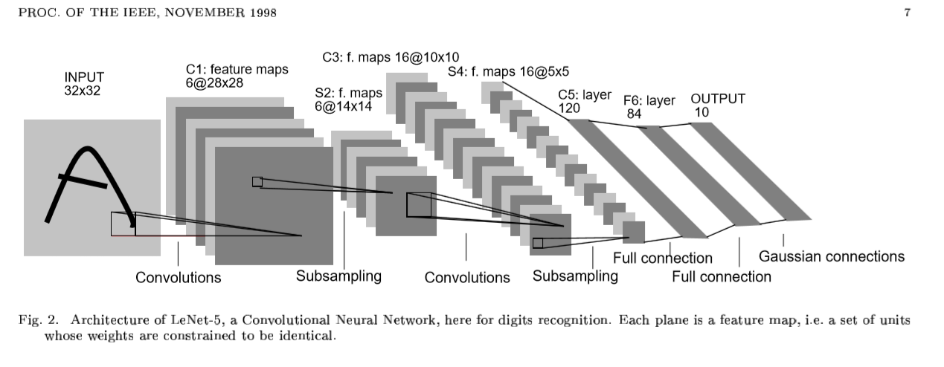
LeNet Architecture
C: Convolution layer, S: subsampling layer, F: Fully Connected layer
Each plane is a feature map

Slide 5
PERFORMANCE INDICATORS
TRUE CLASS
A confusion matrix is used to describe the performance of a classiﬁcation model.
Precision and Recall
Classiﬁcation Accuracy = (TP+TN) /
(TP + TN + FP + FN)
TRUE +
FALSE +
PREDICTIONS
FALSE -
TRUE -

Slide 6
Thank You

